Slide 1
jQuery
Parker Zhou
parkerzho2010@gmail.com

Slide 2

Why jQuery
jQuery is a fast, small, and feature-rich JavaScript library
jQuery makes things like HTML document traversal and manipulation, event handling, animation, and Ajax much simpler
jQuery has changed the way that millions of people write JavaScript

Slide 3
Why jQuery
<div Id=“main”>
<h1>Hello jQuery!</h1>
<div>
<div Id=“main”>
<h1>Hello jQuery!</h1>
<p>jQuery is fast</p>
<div>

Slide 4
Why jQuery
without jquery
var main = document.getELementById(‘main’);
Var p = document.createElement(‘p’);
p.innerHTML = ‘jQuery is fast’;
main.appendChild(p);
with jquery
$(‘#main’).append(‘<p>jQuery is fast </p>’)

Slide 5
jQuery Version
jQuery 1.x : support IE6,7,8. 38.4KB after compressed(v1.11.1)
jQuery 2.x : not support IE6,7,8. 34.1KB after compressed(v2.1.1-rc2)

Slide 6
Topic
Selectors - Methods that provide the ability to access DOM elements by using CSS
Events - Methods that provide the ability to register code to execute when the user interacts with the browser
Ajax - Methods that provide synchronous and asynchronous calls to the server

Slide 7
jQuery Selector
$(‘#main’).append(‘<p>jQuery is fast </p>’)
$(‘div’).append(‘<p>jQuery is fast </p>’)
$(‘.main’).append(‘<p>jQuery is fast </p>’)
$(‘div[role=main]’).append(‘<p>jQuery is fast </p>’)

Slide 8
jQuery Events
$(‘button’).click(function(){
…
})
$(‘body’).on(‘click’ , ’button’ , function(){
…
})

Slide 9
jQuery Ajax
$.ajax({
url: ‘http://clouddoc.sinaapp.com/resources?pid=’,
type:’GET’
success: function(){…},
error: function(){…}
})

Slide 10
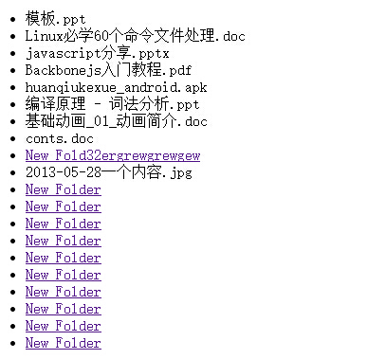
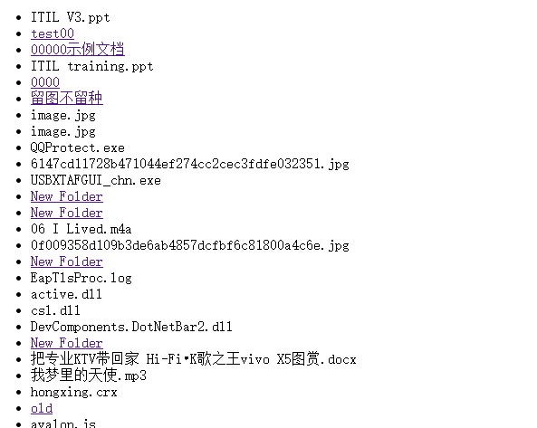
Example
Web File Explorer
Click a folder will show the subitems of the folder
Notes:
http://clouddoc.sinaapp.com/resources?pid=
file_name
id
type

